Slide 1
Shell Bootcamp 2024 3 Reflections for Week
Sriya Nukala
Date : 30-Aug-2024

Slide 2

About Me
Continuous learning fuels endless growth. Looking forward to working and connecting with inspiring people.

Slide 3

My learnings from this week!

Slide 4
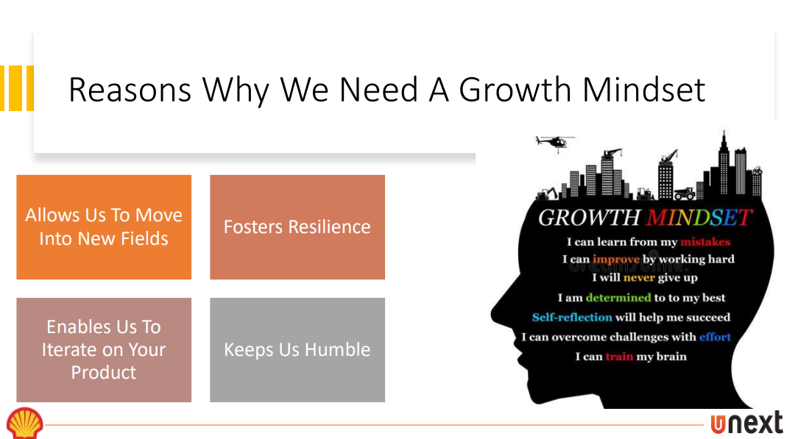
Learning 1 | My takeaways
Professional behavior include Integrity, Self awareness, professional qualities, managing complexities and new world imperatives.
Employees should adapt the habit of having growth mindset rather than having a fixed mindset in order to grow in their professional career.
Grooming is very important to make an impression, makes one feel confident. It includes personal hygiene, attire.

Slide 5
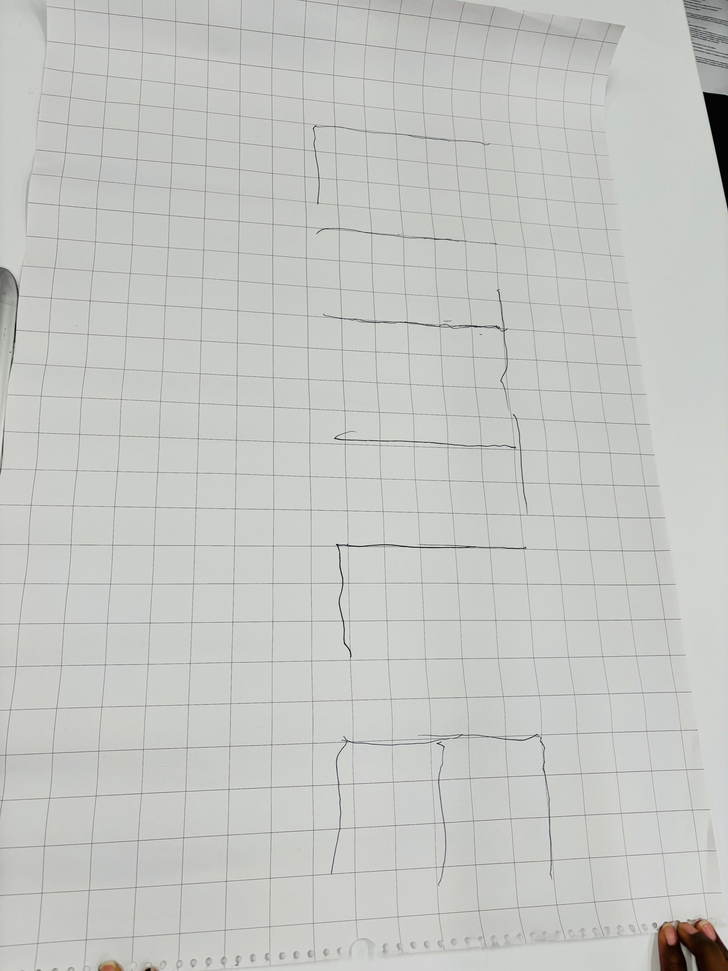
Learning 2 | My takeaways
Team work
Important aspects of the team are Integrity, Coordination, Communication, Respect and Trust
This is very important aspect in professional career. Team should be very coordinative and every member of the team should respect ones opinion. Every member of the team should feel included.

Slide 6
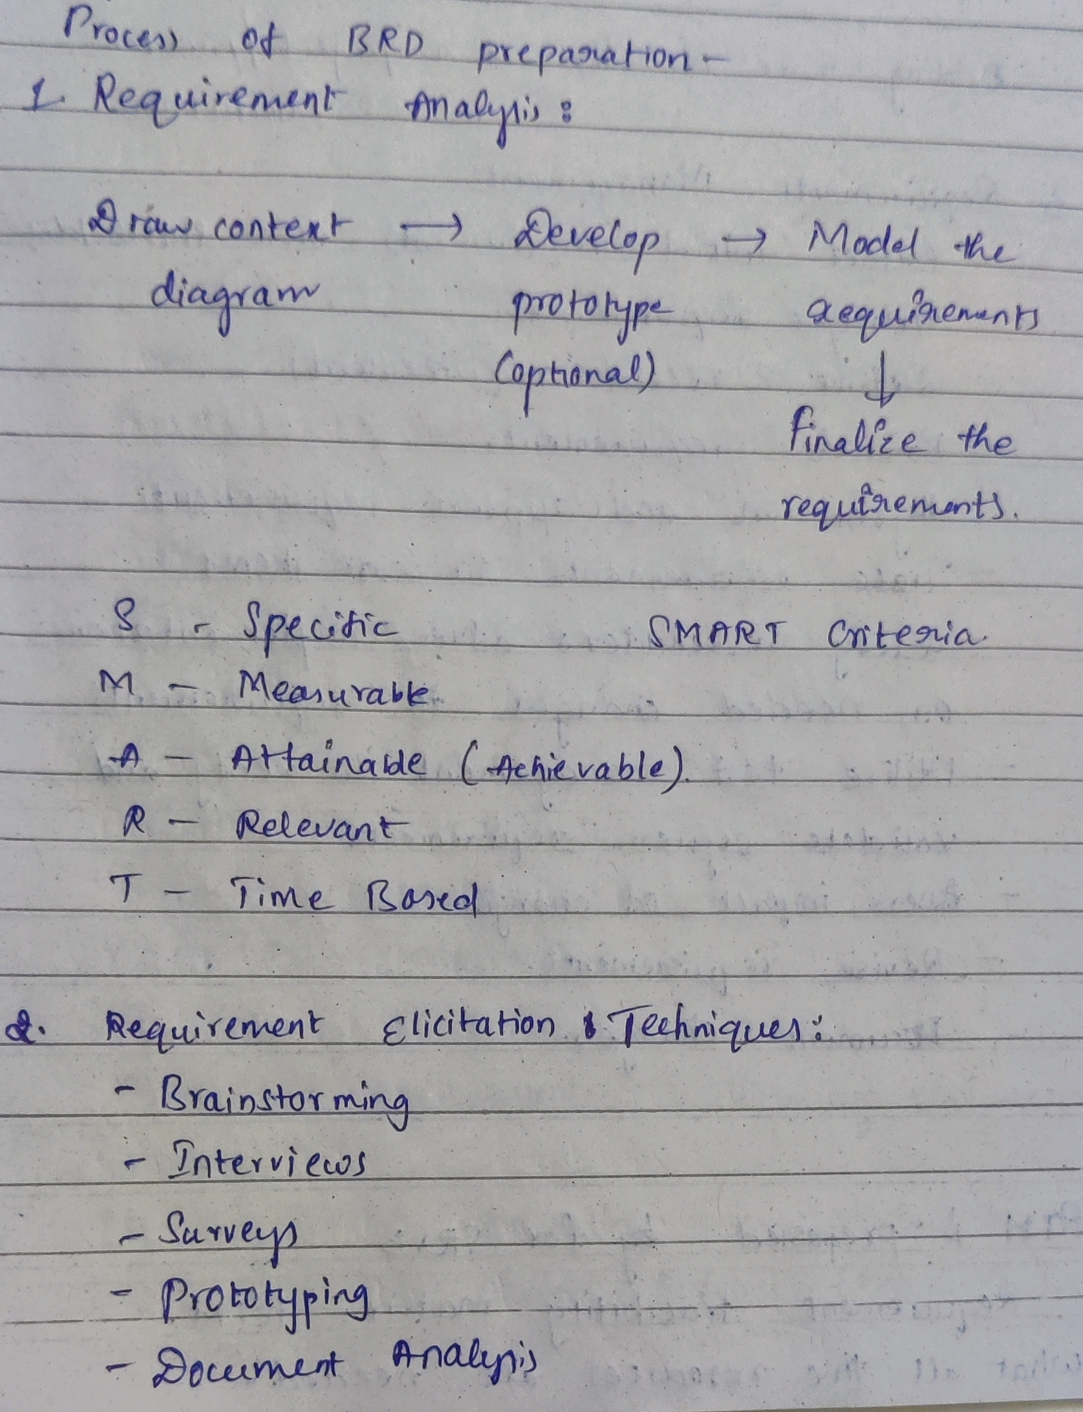
Learning 3 | My takeaways
Business Requirement Document (BRD) and Software Specification Document (SRS)
Importance of Business Requirement Document (BRD) and Software requirement Specifications Document (SRS)
In Energy Sector while taking up the projects BRD will be prepared by Product Owner/ Business Analyst and then after the project is finalized PO will prepare the SRS Document which contains all the technical specifications of the project. So this is important in every sector.

Slide 7

Relevance of learnings for my organization

Slide 8
Learning 1 | Relevance for Shell
As professionalism is important aspect all the employees need to know the importance of it and if the employees perform Growth mindset, then one will grow in their career and in turn if the employees grow automatically the company will also grow. In this way Shell will also be benefited.
[Add a graphic that provides view of how Shell implements this learning]

Slide 9
Learning 2 | Relevance for Shell
Shell doesn’t have any hierarchical mode of working . It doesn’t show any difference between freshers and experienced people such as having separate cabins for project leads and managers are also so much cooperative with team members.
Every project has a team so if the team works collectively without any problem with due respect on each other then the project will go on smoothly. If the team works in this way then Shell will also be benefited.

Slide 10
Learning 3 | Relevance for Shell
Shell has provided freshers with foundation bootcamp where they are teaching all the details regarding how project proposal will be, what is the importance of SRS and BRD document, so that all members in the chain will be able to know what is going on in the project and how an employee is contributing to it. If the employee understands that he is contributing then it will be self satisfactory for an employee and works by putting in great effort which will be benefit for the company.

Slide 11

Challenges in implementing learning

Slide 12
Challenge faced while implementing Learning 1
Our facilitator assigned us an activity to perform a roleplay on Growth mindset vs Fixed mindset. So, we came up with a scenario in workplace that to have two interns , manager and HR. One intern shows fixed mindset and other shows growth mindset. First, we thought of interns having conversation with manager as well but there was time constraint, so we just cut down that conversation and came to single opinion of interns having conversation with HR . There we added the dialogues which depicts the growth and fixed mindset.
[Add a graphic that provides evidence of what you did to overcome this challenge]

Slide 13
Challenge faced while implementing Learning 2
When facilitator gave the task based on teamwork, the activity was to write a six-letter word with a pen tied to four strings from four directions and now using these ends of the strings four people should write the word. At first, we found the difficulty in making the pen perpendicular to the paper then we went on a plan by making another knot in the opposite direction and executed it with coordination.
[Add a graphic that provides evidence of what you did to overcome this challenge]

Slide 14
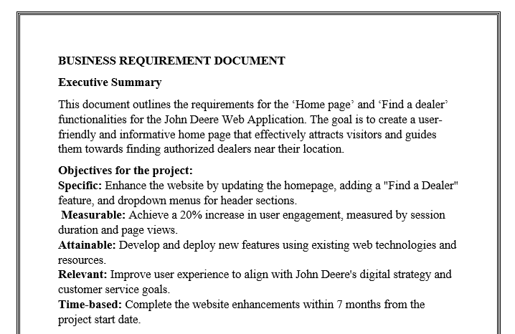
Challenge faced while implementing Learning 3
During the activity given by the facilitator to create Business Requirement Document (BRD) and Software Requirement Specification Document (SRS) we went offtrack combining the fields of both the documents then again by observing the presentations given by other teams and asking the help from our facilitator we were able to know what fields should be included in SRS and BRD.

Slide 15

Action Plan

Slide 16
My Action Plan for this Week
Actions
Timeline
Status
Network with people a lot. Try to schedule GTKYs. Try communicating with new people.
Next week
I learned about the importance of team coordination, Active listening, growth mindset, professionalism and how to prepare BRD and SRS documents.

Slide 17

Learning is also Fun!

Slide 18
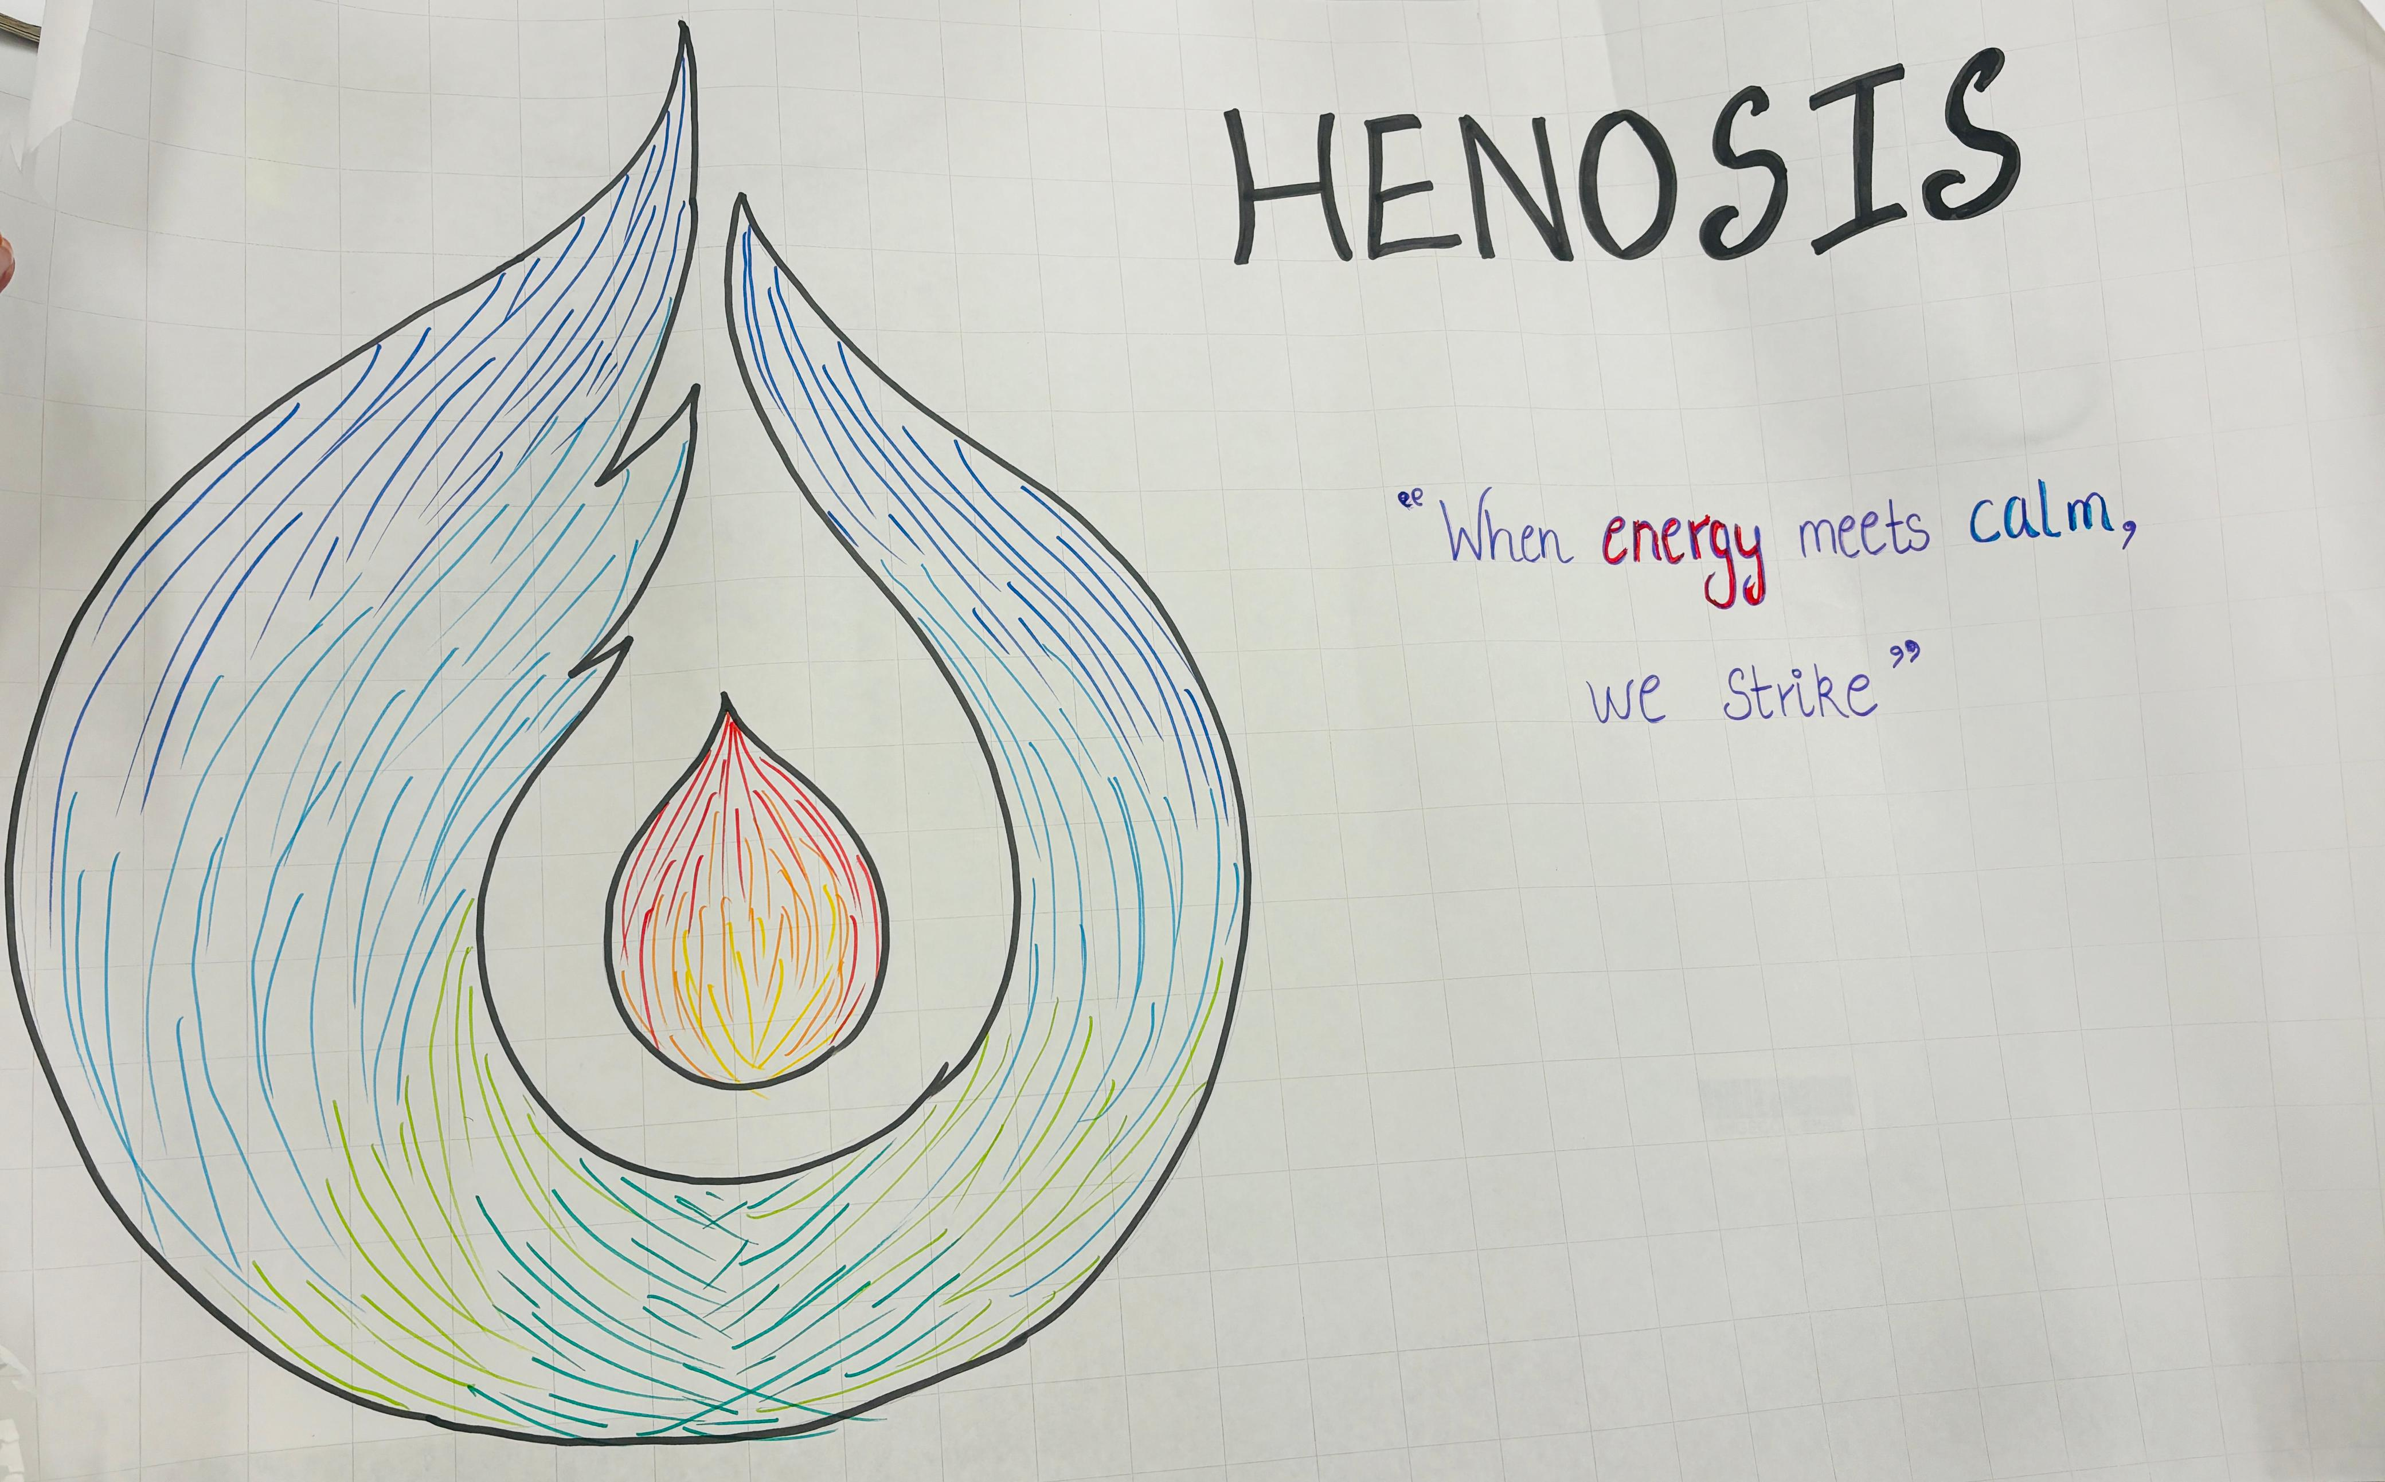
Learning is also Fun!
We had an activity, where we need to prepare a logo which represents our team. We should also come up with a tagline and team name.
Team is combination of different kinds of mindsets. So we came up with a logo collectively but we had different opinions for the name of the team. Then we came to a conclusion collectively with a good team name.

Slide 19

Summary
Overall this week’s learning was good. We had many fun activities at the same time we learnt many important concepts that are required for our growth.
Technical topics such as DBMS, OS, PostgreSQL
After preparing SRS document team will decide which language to be used, which database should be selected and the application/ website should work on which type of OS. So, these are all important. We will be learning all these things in this upcoming week.

Slide 20
Thank You

